Slide 1

Application Layer Protocols
and
Services -3
Delivered By:
Avinash Bhagat
9463281930
avinash.bhagat@lpu.co.in
Copyright © The McGraw-Hill Companies, Inc. Permission required for reproduction or display.

Slide 2
Domain Name System (DNS) Chapter 25
TELNET Chapter 26
Simple Mail Transfer Protocol and Post Office Protocol Chapter 26
File Transfer Protocol Chapter 26
World Wide Web www Chapter27
Hyper text transfer Protocol HTTP Chapter27
Terminologies in Network Security Chapter30
Firewalls Chapter32
Virtual Private Network (VPN) Chapter32

Slide 3
Between1970 to about 1990, the Internet and its predecessors had four main applications:
Remote Logging,
Electronic Mail,
File Transfer
News
Copyright © The McGraw-Hill Companies, Inc. Permission required for reproduction or display.

Slide 4
ELECTRONIC MAIL
One of the most popular Internet services is electronic mail (e-mail).
At the beginning of the Internet era, the messages sent by electronic mail were short and consisted of text only.
Today, electronic mail is much more complex. It allows a message to include text, audio, and video.
It also allows one message to be sent to one or more recipients.

Slide 5
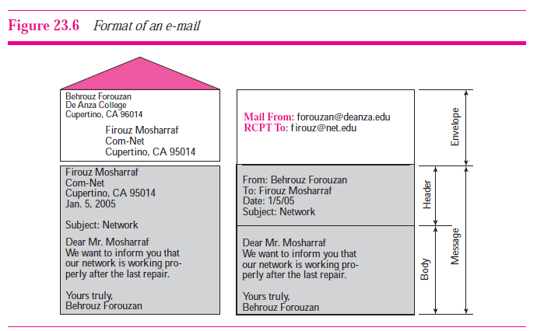
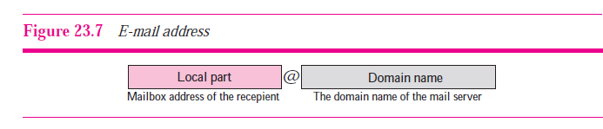
E-mail format

Slide 6

Architecture of e-mail
Architecture of e-mail service is based on the following four scenarios:
First Scenario
When the sender and the receiver of an e-mail are on the same system, we need only two user agents. A mailbox is part of a local hard drive, a special file with permission restrictions. Only the owner of the mailbox has access to it.

Slide 7
Components of e-mail System
User Agents(UA)
User agent is software (a software agent) that is acting on behalf of a user.
One common use of the term refers to a web browser telling a website information about the browser and operating system.
This allows the website to customize content for the capabilities of a particular device.

Slide 8
Components of e-mail System
User Agents(UA)
      Command-Driven:
      Some examples of command-driven user agents are mail, pine, and elm.
      GUI-based:
      Eudora, Outlook, and Netscape

Slide 9

Service provided by mail User Agents

Slide 10

Second Scenario
    When the sender and the receiver of an e-mail are on different systems, we need two UAs and a pair of MTAs (client and server).

Slide 11
2. Message Transfer Agent (MTA): SMTP
The actual mail transfer is done through message transfer agents (MTAs).
To send mail, a system must have the client MTA, and to receive mail, a system must have a server MTA.
The formal protocol that defines the MTA client and server in the Internet is called the Simple Mail Transfer Protocol (SMTP).

Slide 12
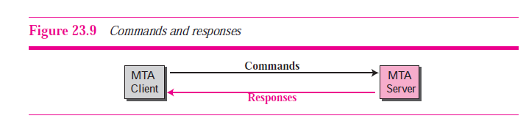
2. Message Transfer Agent (MTA): SMTP
SMTP simply defines how commands and responses must be sent back and forth.
Each network is free to choose a software package for implementation.

Slide 13
2. Message Transfer Agent (MTA): SMTP
Hidden from the average user, the message transfer agent is responsible for routing messages to their proper destinations.
An MTA implements both the client (sending) and server (receiving) portions of the Simple Mail Transfer Protocol

Slide 14

Third Scenario
    When the sender is connected to the mail server via a LAN or a WAN, we need two UAs and two pairs of MTAs (client and server).

Slide 15

Fourth Scenario
    When both sender and receiver are connected to the mail server via a LAN or a WAN, we need two UAs, two pairs of MTAs (client and server), and a pair of MAAs (client and server). This is the most common situation today.

Slide 16
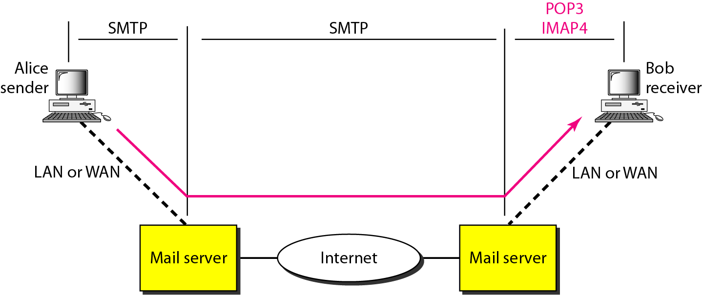
Message Access Agent (MAA)
SMTP is not involved in the third stage because SMTP is a push protocol; it pushes the message
from the client to the server. On the other hand, the third stage needs a pull protocol; the
client must pull messages from the server

Slide 17
Message Access Agent (MAA)
Currently two message access protocols are available: Post Office Protocol, version 3
(POP3) and Internet Mail Access Protocol, version 4 (IMAP4)

Slide 18
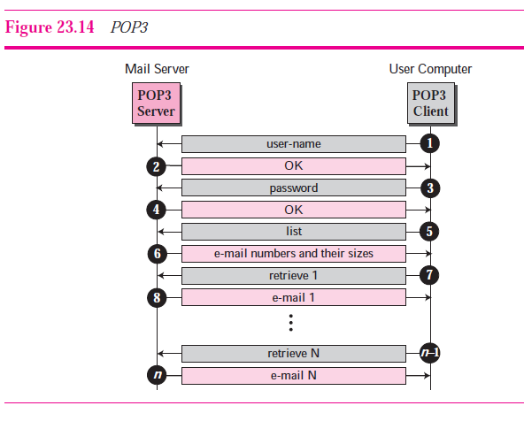
3. Message Access Agent (MAA)
  Post Office Protocol, version 3 (POP3)

Slide 19
3. Message Access Agent (MAA)
  Post Office Protocol, version 3 (POP3)
POP3 has two modes:
Delete mode mail is deleted from the mailbox after each retrieval.
The delete mode is normally used when the user is working at her permanent computer and can save and organize the received mail after
reading or replying.

Slide 20
3. Message Access Agent (MAA)
  Post Office Protocol, version 3 (POP3)
Keep mode. Mail remains in the mailbox after retrieval.
The keep mode is normally used when the user accesses her mail away from her primary computer (e.g., a laptop). The mail is read but kept in the system for later retrieval

Slide 21
3. Message Access Agent (MAA)
  IMAP4 Internet Mail Access Protocol
POP3 is deficient in several ways.
It does not allow the user to organize her mail on the server; the user cannot have different folders on the server.
It does not allow the user to partially check the contents of the mail before downloading.

Slide 22
3. Message Access Agent (MAA)
  IMAP4 provides following extra functions
  User can check the e-mail header prior to downloading.
  User can search the contents of the e-mail for a specific string of characters prior to downloading.
  User can partially download e-mail. This is especially useful if bandwidth is limited and the e-mail contains multimedia with high bandwidth requirements.
  User can create, delete, or rename mailboxes on the mail server.
  User can create a hierarchy of mailboxes in a folder for e-mail storage.

Slide 23
Subjective
  Explain e-mail service architecture
  Differentiate between POP and IMAP.
  Functions of MAA
  Functions of MTA
  Functions of UA

Slide 24
Multiple Choice questions
  When the sender and the receiver of an email are on the same system, we need only ___________.
  a. one UA
  b. two UAs
  c. one UA and one MTA
  d. none of the above

Slide 25
Multiple Choice questions
  When the sender and the receiver of an email are on the same system, we need only ___________.
  a. one UA
  b. two UAs
  c. one UA and one MTA
  d. none of the above

Slide 26
Multiple Choice questions
When the sender and the receiver of an email are on different systems, we need only _____________.
a. one MTA
b. two UAs
c. two UAs and one pair of MTAs
d. none of the above

Slide 27
Multiple Choice questions
When the sender and the receiver of an email are on different systems, we need only _____________.
a. one MTA
b. two UAs
c. two UAs and one pair of MTAs
d. none of the above

Slide 28
Multiple Choice questions
When the sender is connected to the mail server via a LAN or a WAN, we need ______________.
a. two MTA
b. two UAs and two pairs of MTAs
c. two UAs and a pair of MTAs
d. none of the above

Slide 29
Multiple Choice questions
When the sender is connected to the mail server via a LAN or a WAN, we need ______________.
a. two MTA
b. two UAs and two pairs of MTAs
c. two UAs and a pair of MTAs
d. none of the above

